Slide 1

IMDB Movie Analysis
- A project report by J.Athreya Sharma

Slide 2

A) Cleaning the data
Description: The first task is to clean the data . This cleaning of data can be done by dropping columns which are not required, removing null values , replacing the null values with some valid values.
Approach: After downloading the dataset I have removed some unnecessary columns for this analysis like (Color, director_facebook_likes, actor_3_facebook_likes, actor_2_name, actor_1_facebook_likes, cast_total_facebook_likes, actor_3_name, facenumber_in_posts, plot_keywords, movie_imdb_link, content_rating, actor_2_facebook_likes, aspect_ratio, movie_facebook_likes) . And after that I have removed duplicate values and null values.
Tech-Stack used: MS- Excel
Insights: Cleaning data is the first and crucial step for data analysis it is indeed essential in order to get better results and insights of data.
Result: The before and after cleaning of dataset snippets are attached in the next slide.

Slide 3
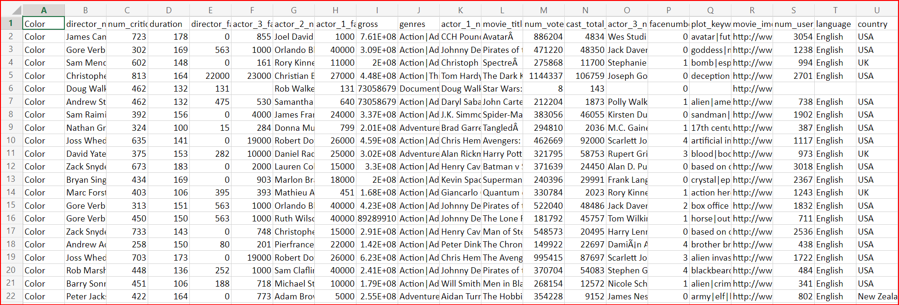

Slide 4
Before cleaning the data set the ref link:- https://raghuenggcollegein-my.sharepoint.com/:x:/g/personal/20981a4427_raghuenggcollege_in/EbQ4AiIkEn1FnHVFZIoELMUBF5bNxAA_7mg9daznKDvwpQ?e=jWHsAv&nav=MTVfe0VDQ0IxNDczLTg3NTUtNDA1OC1COTlFLUI4NDEyMUNCQTlBQn0

Slide 5
After replacing the null values and removing unnecessary columns the dataset is modified as follows also the link for the dataset is as follows: https://raghuenggcollegein-my.sharepoint.com/:x:/g/personal/20981a4427_raghuenggcollege_in/EbQ4AiIkEn1FnHVFZIoELMUBF5bNxAA_7mg9daznKDvwpQ?e=CO0MGr&nav=MTVfezAwMDAwMDAwLTAwMDEtMDAwMC0wMDAwLTAwMDAwMDAwMDAwMH0

Slide 6
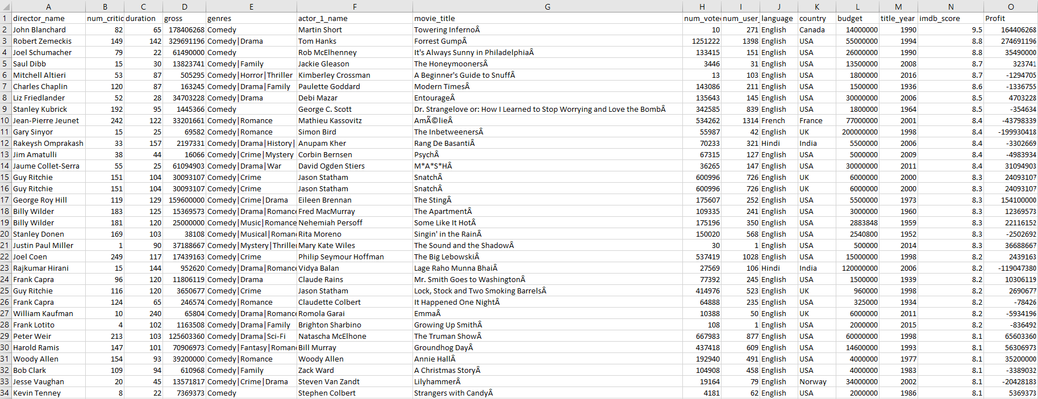

Slide 7
B) Movie with highest profit
Description: The task is to create a column called profit which contains difference of 2 columns gross and budget. Sort the column using the profit column as a reference. After this we have to plot a graph for the both columns.
Approach: We will use the formula D2-L2 and apply it to the whole column named profit and we will sort it in descending order then we will get the movies with highest profit. In order to get a better graph I have divided the column budget and profit by 1000000 and removed decimal places in profit column using int() function.
Tech-Stack used: MS- Excel
Insights: Using this task we can find the high profited movies in the dataset
Result: The top 5 movies along with their profit is represented as a bar chart in the next slide and also the plot between budget and profit snippet is attached . The link for the excel sheet is: https://raghuenggcollegein-my.sharepoint.com/:x:/g/personal/20981a4427_raghuenggcollege_in/EbQ4AiIkEn1FnHVFZIoELMUBF5bNxAA_7mg9daznKDvwpQ?e=yWyaVP&nav=MTVfe0M5MTdFNzE4LTRFRjktNDk0NS1BMDI0LUM3ODRBMkZGQzA1NX0

Slide 8
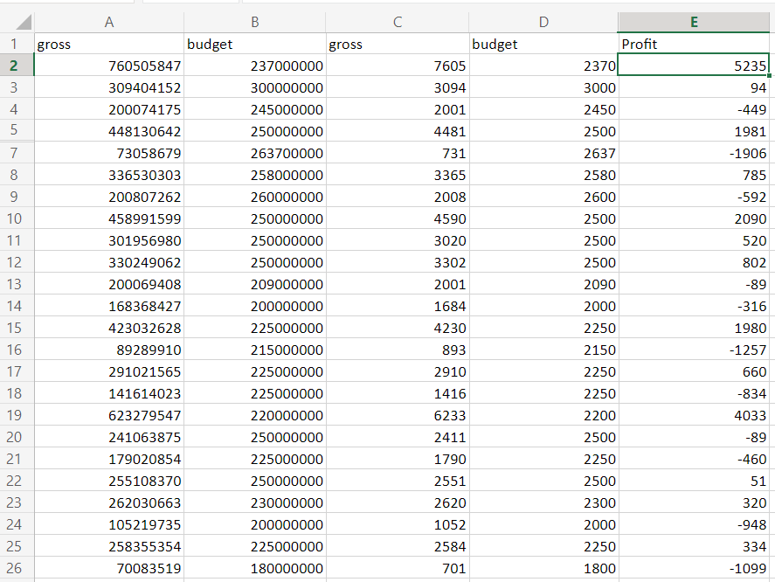

Slide 9
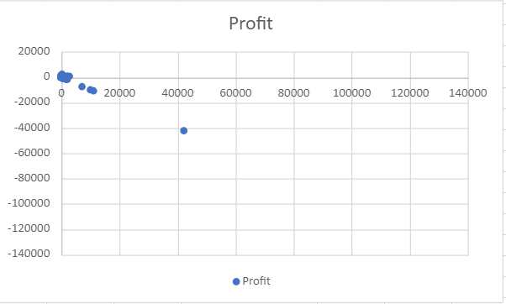

Slide 10
C) Top 250
Description: The task is to create a new column called IMDb_Top_250 and store top 250 movies with highest IMDb rating corresponding to column imbd_score. Also we have to make sure that for all these movies num_voted_users is greater than 25000. We also have to add a rank column containing values 1 to 250 and also have to another column called Top_foreign_lang_Film in which we have to store all those movie whose language is not English.
Approach: First of all we will create a pivot table of all the columns : movie_title ,num_voted_users, language, imdb_score and after applying filter on the column num_voted_users >25000 we will sort the data on the basis of imdb_score column in descending order and rank these columns from 1 to 250.
Tech-Stack used: MS- Excel
Insights: Using this task we can find the top 250 movies rated by IMDb.
Result: The top 250 IMDb rated films and also foreign language film snippets are attached in the next 5 slides.

Slide 11
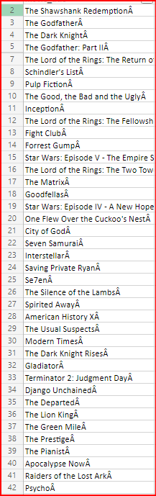
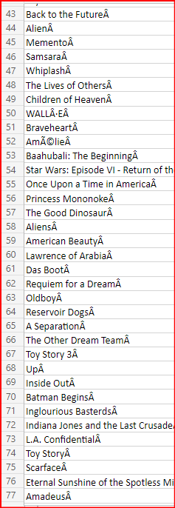
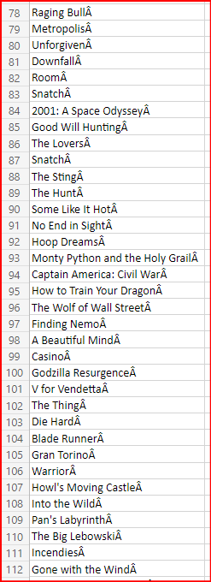

Slide 12
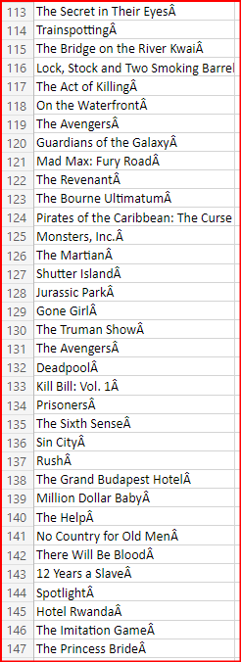
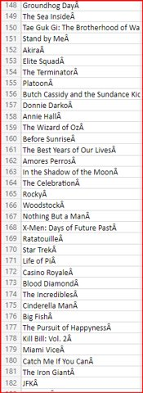
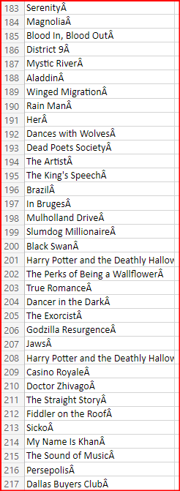

Slide 13
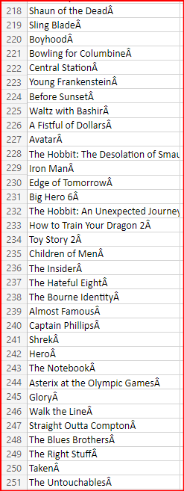
https://raghuenggcollegein-my.sharepoint.com/:x:/g/personal/20981a4427_raghuenggcollege_in/EWaSIgoVLuxKqQWu9Lb9y6oBCSgV1dB77BKk_eAQ7pdWng?e=GWOhhi&nav=MTVfe0Y5NzBCNkNDLTFCQkItNEQzNS05RDExLUJGNjdCMjJDMkFFMH0

Slide 14

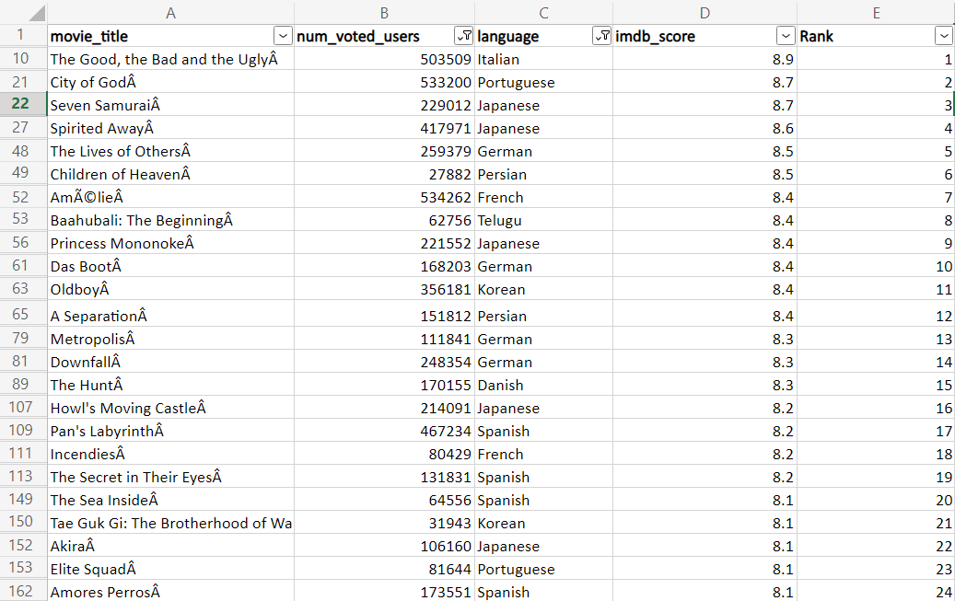

Slide 15
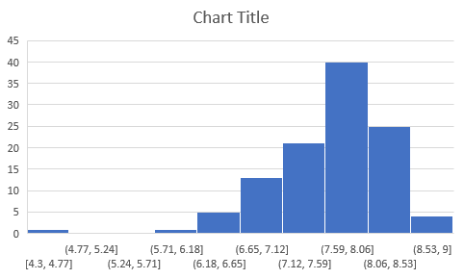
https://raghuenggcollegein-my.sharepoint.com/:x:/g/personal/20981a4427_raghuenggcollege_in/EbQ4AiIkEn1FnHVFZIoELMUBF5bNxAA_7mg9daznKDvwpQ?e=AUboRn&nav=MTVfezMwNjc3OTg3LTE4RUMtNDZFRi1BREU2LTYxQTY3RTJGOTdDMH0

Slide 16
D) Best Directors
Description: The task is to find out the top 10 directors for whom the mean of imdb_score is highest and store them in a new column called top10director. In case of tie in IMDb score between 2 directors sort them alphabetically.
Approach: To find the top 10 directors first we will create a pivot table of the columns director_name and imdb_score after this we will select value settings and click on average and after this we will apply filter on the the average_of_imdb_score column in that we will select value settings and click on top 10 we will get the top 10 directors.
Tech-Stack used: MS- Excel
Insights: Using this task we can find the top 10 best directors
Result: The 10 best directors and their imdb score snippet is attached In the next slide. The link for the dataset is : https://raghuenggcollegein-my.sharepoint.com/:x:/g/personal/20981a4427_raghuenggcollege_in/EbQ4AiIkEn1FnHVFZIoELMUBgx1grX-m98EJdNBMizqBhA?e=D9wfYa&nav=MTVfe0MzREE2OTZELTVCNTItNDBBOC1CNTU3LTFEMkMzQ0QwQUI0RH0

Slide 17
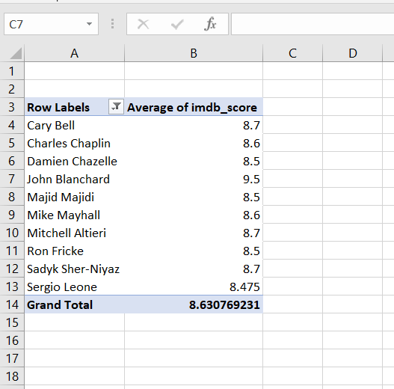

Slide 18
E) Popular Genres
Description: The task is to find out the popular genres with reference to the previous statements.
Approach: To find the popular genres in the dataset we have to separate the cells having ‘|’ to find correct count of the genres , to implement that I have used the formula =TRIM(MID(SUBSTITUTE($A2,"|",REPT(" ",LEN($A2))), (COLUMN()-COLUMN($B1))*LEN($A2)+1, LEN($A2))) to separate multiple genres in each cell of “genres” column and places them in separate rows in “genre” column and now we will count the occurrences using the formula =COUNTIF(B:B,B2)
Tech-Stack used: MS- Excel
Insights: Popular genre is an important criteria in films as it helps directors to choose correct genre according to its popularity.
Result: The Popular genres along with non popular genres snippet is attached in the next slide.
The link for the dataset is: https://raghuenggcollegein-my.sharepoint.com/:x:/g/personal/20981a4427_raghuenggcollege_in/EbQ4AiIkEn1FnHVFZIoELMUBgx1grX-m98EJdNBMizqBhA?e=hfXQSb&nav=MTVfezMzNzQyNzdCLUI5QkQtNDI1Qi05QUZCLUFGN0UzQ0RCNjc2Qn0

Slide 19
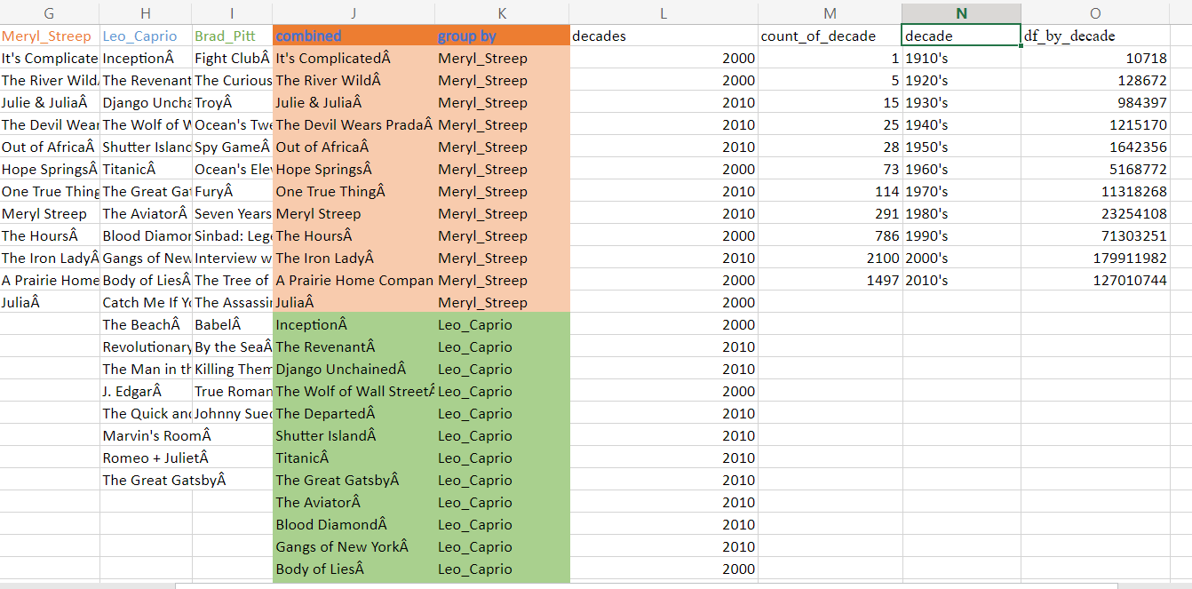

Slide 20
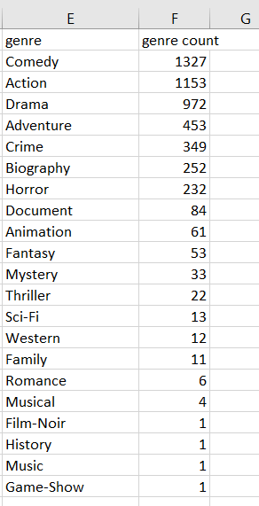

Slide 21
F) Charts
Description: The task is to create 3 columns namely, Meryl_Streep,Leo_Caprio and Brad_Pitt which contains movies in which the actors are the lead actors and combine the rows of these columns into a new column named “Combined”.After this we have to observe the change in number of voted users over decades using a bar chart.
Approach: To implement this we will the three columns mentioned and another combined combining all the three columns after this we will create a decade column using the formula =INT(F2/10)*10 where F is the title_year column and then categorize them and into count column using column =COUNTIF(M:M, "1910")
Tech-Stack used: MS- Excel
Insights: This bar graphs are used extensively when we want to monitor data which has 2 parameters.
Result: The 2 columns decade, df_by_decade along with a bar graph for these columns is attached in the snippet in next slide.
The link for the dataset is: https://raghuenggcollegein-my.sharepoint.com/:x:/g/personal/20981a4427_raghuenggcollege_in/EbQ4AiIkEn1FnHVFZIoELMUBF5bNxAA_7mg9daznKDvwpQ?e=Dh9vj4&nav=MTVfezg4OUY1NEUyLTZGMzEtNEYwMS04MkNDLTEyNTYyMDcyNjlBNX0
The link for pie charts is:https://raghuenggcollegein-my.sharepoint.com/:x:/g/personal/20981a4427_raghuenggcollege_in/EbQ4AiIkEn1FnHVFZIoELMUBgx1grX-m98EJdNBMizqBhA?e=l99Zee&nav=MTVfe0I0QTc2REEzLTE2MTctNEM2NS04MDYwLTRFNzUzNDFBNzY5NX0

Slide 22
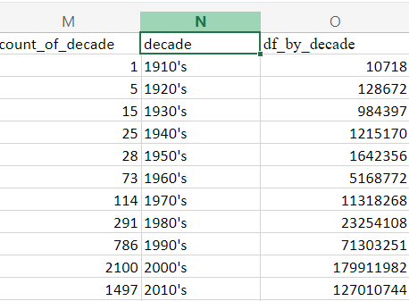
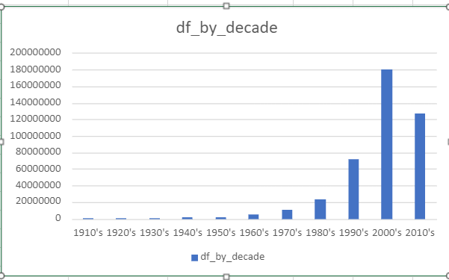

Slide 23
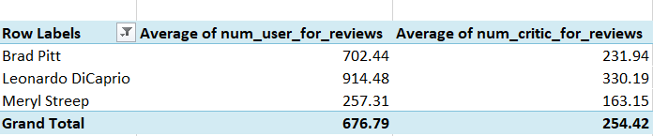

Slide 24


